Slide 1
Walldo Project #4
Technical Presentation
Brice Petty
Johnny Elderton
Evan Downard

Slide 2
Description
GPS tracking device
Record useful travel measurements
Primary focus on tracking vehicle travel
Small enough to hide in almost anything
Uses for Waldo are subject to the user’s imagination

Slide 3
Overall
Walldo (Hardware)
Excluding software support (we’re still working on it)
How to design:
Selecting the correct components
Soldering and wiring
GPS systems
Implementing other components
How to use:
Arduino IDE
Doggo

Slide 4
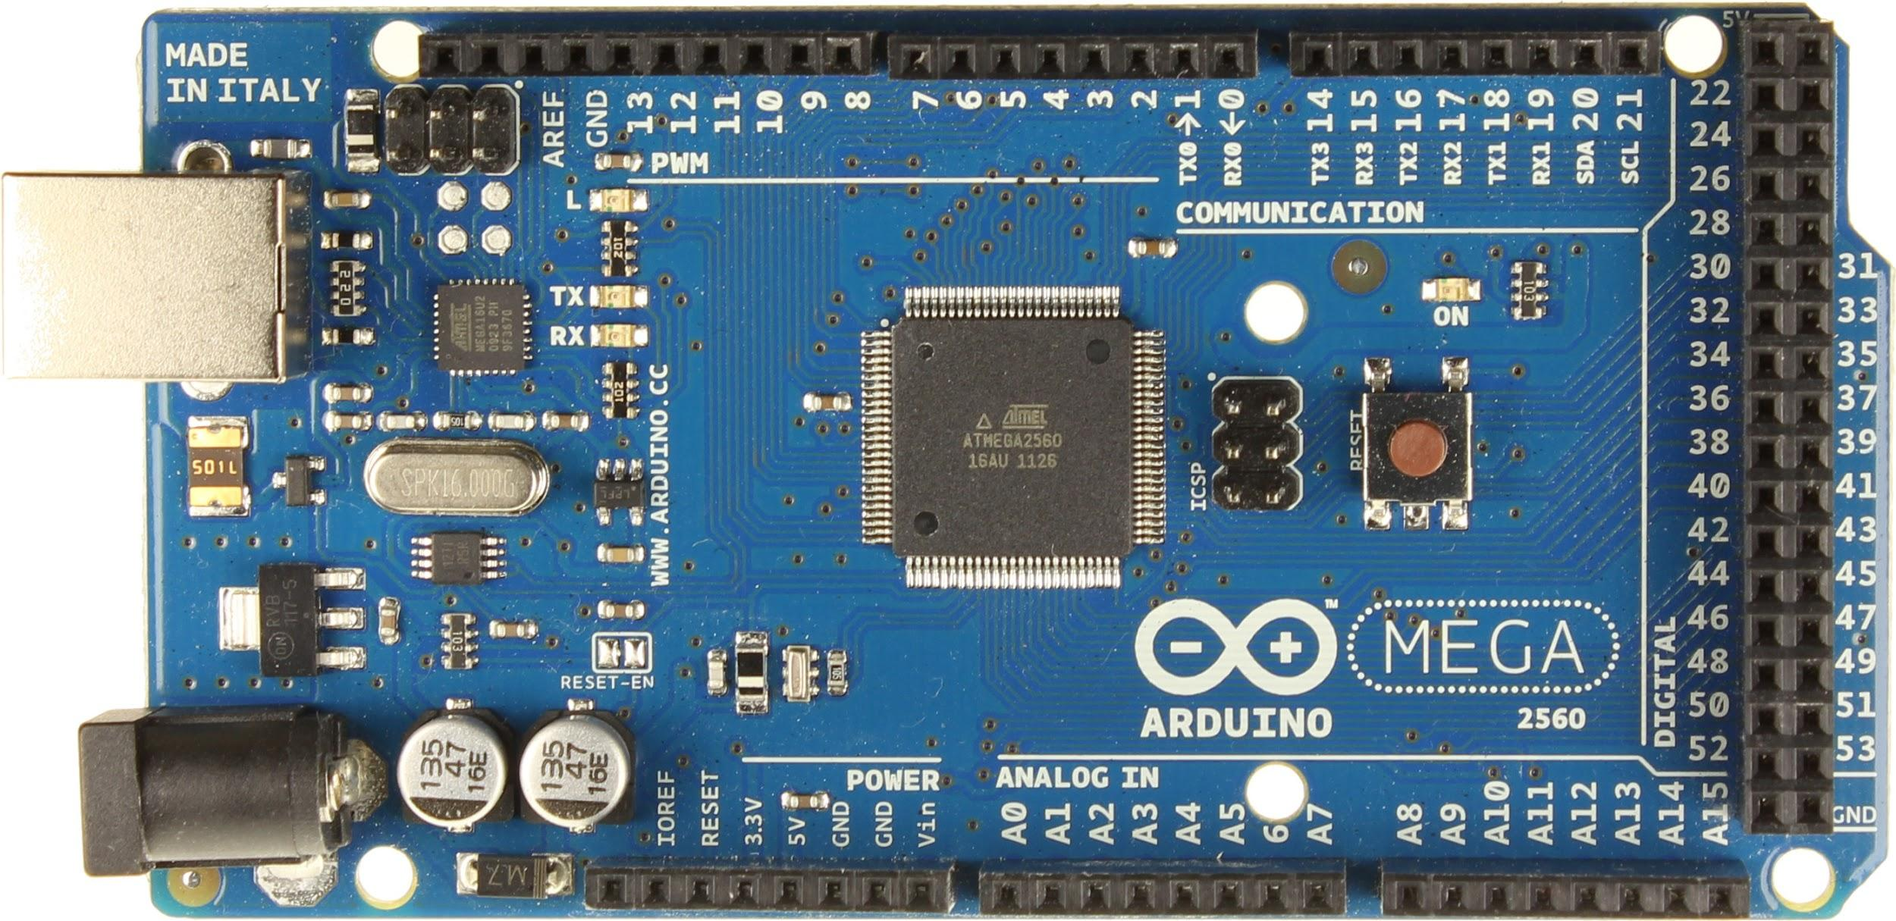
Platform (Arduino MEGA)
Open Source Microcontroller
User Friendly Prototyping
Manageable IDE
Programmed in Embedded C
ATmega2560 chipset
https://www.arduino.cc/

Slide 5

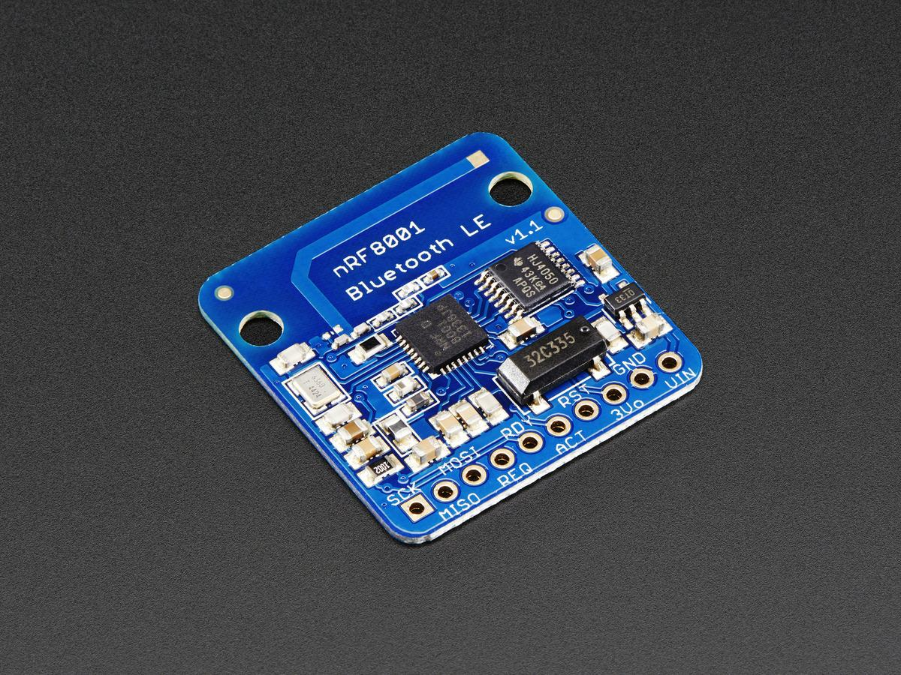
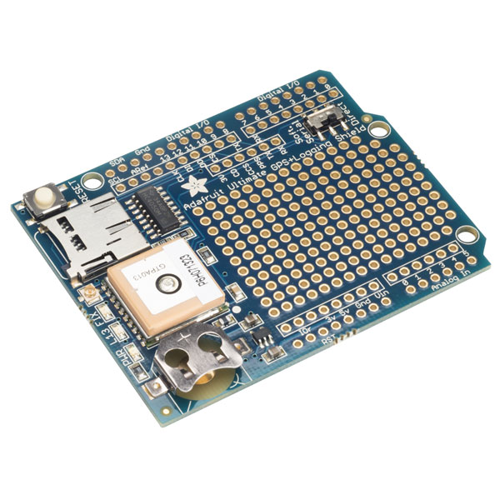
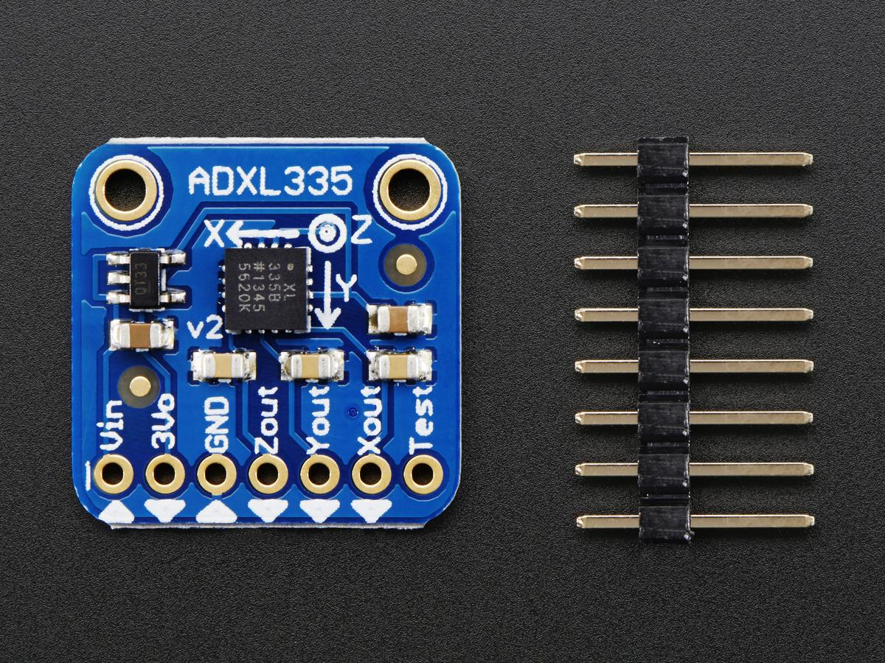
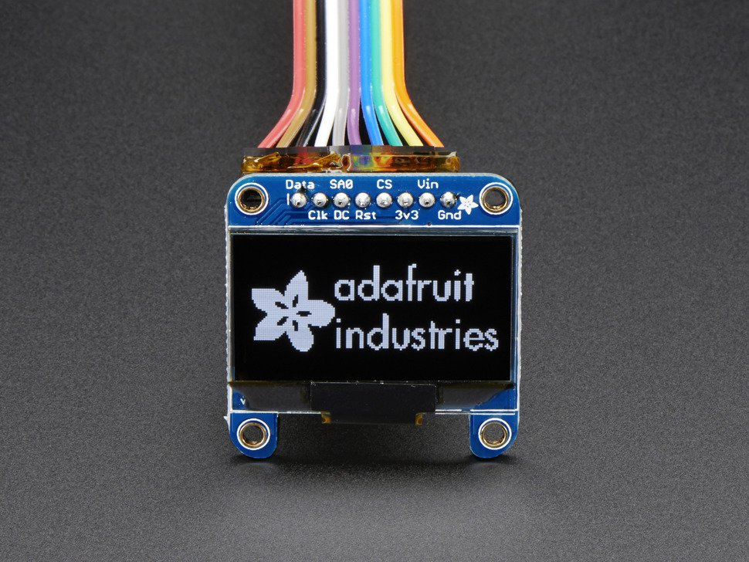



Hardware (Adafruit)
Arduino Leonardo Mega (see platform)
Adafruit i2C OLED Display
Adafruit Ultimate GPS Shield
Adafruit Bluetooth
Adafruit Accelerometer
Adafruit offers guides, libraries and example projects on their website for almost all of their hardware.
https://www.adafruit.com/

Slide 6
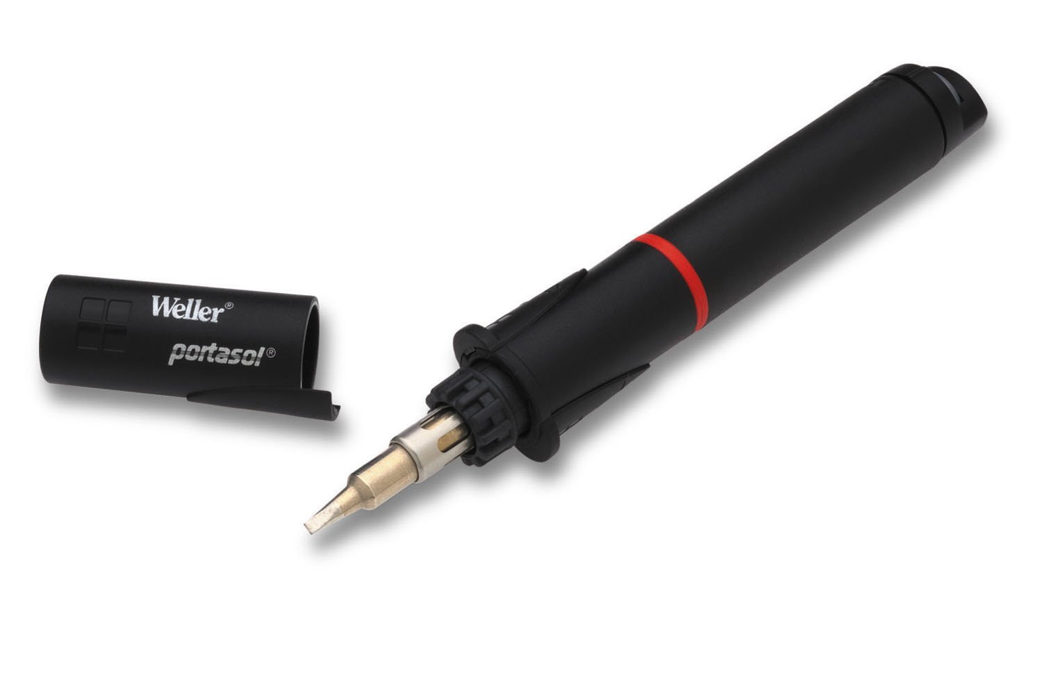
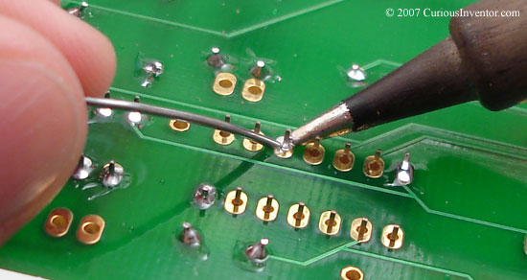
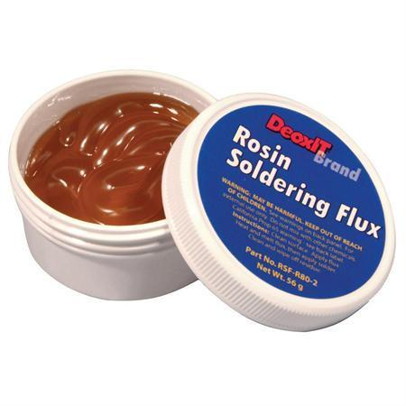
Soldering
Soldering Iron
Flux
Solder
Sponge
Apply a small amount of flux to the connection you intend to solder
Apply the heated iron to one side of the connection first
Apply solder to the opposite end of the connection second
Keep iron clean by removing excess solder/oxidation with damp sponge
Avoid breathing solder smoke/fumes
Get one of these. I found mine on Amazon and it’s been fantastic! Butane = you can solder outdoors

Slide 7
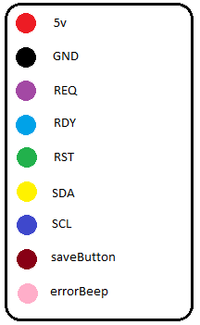
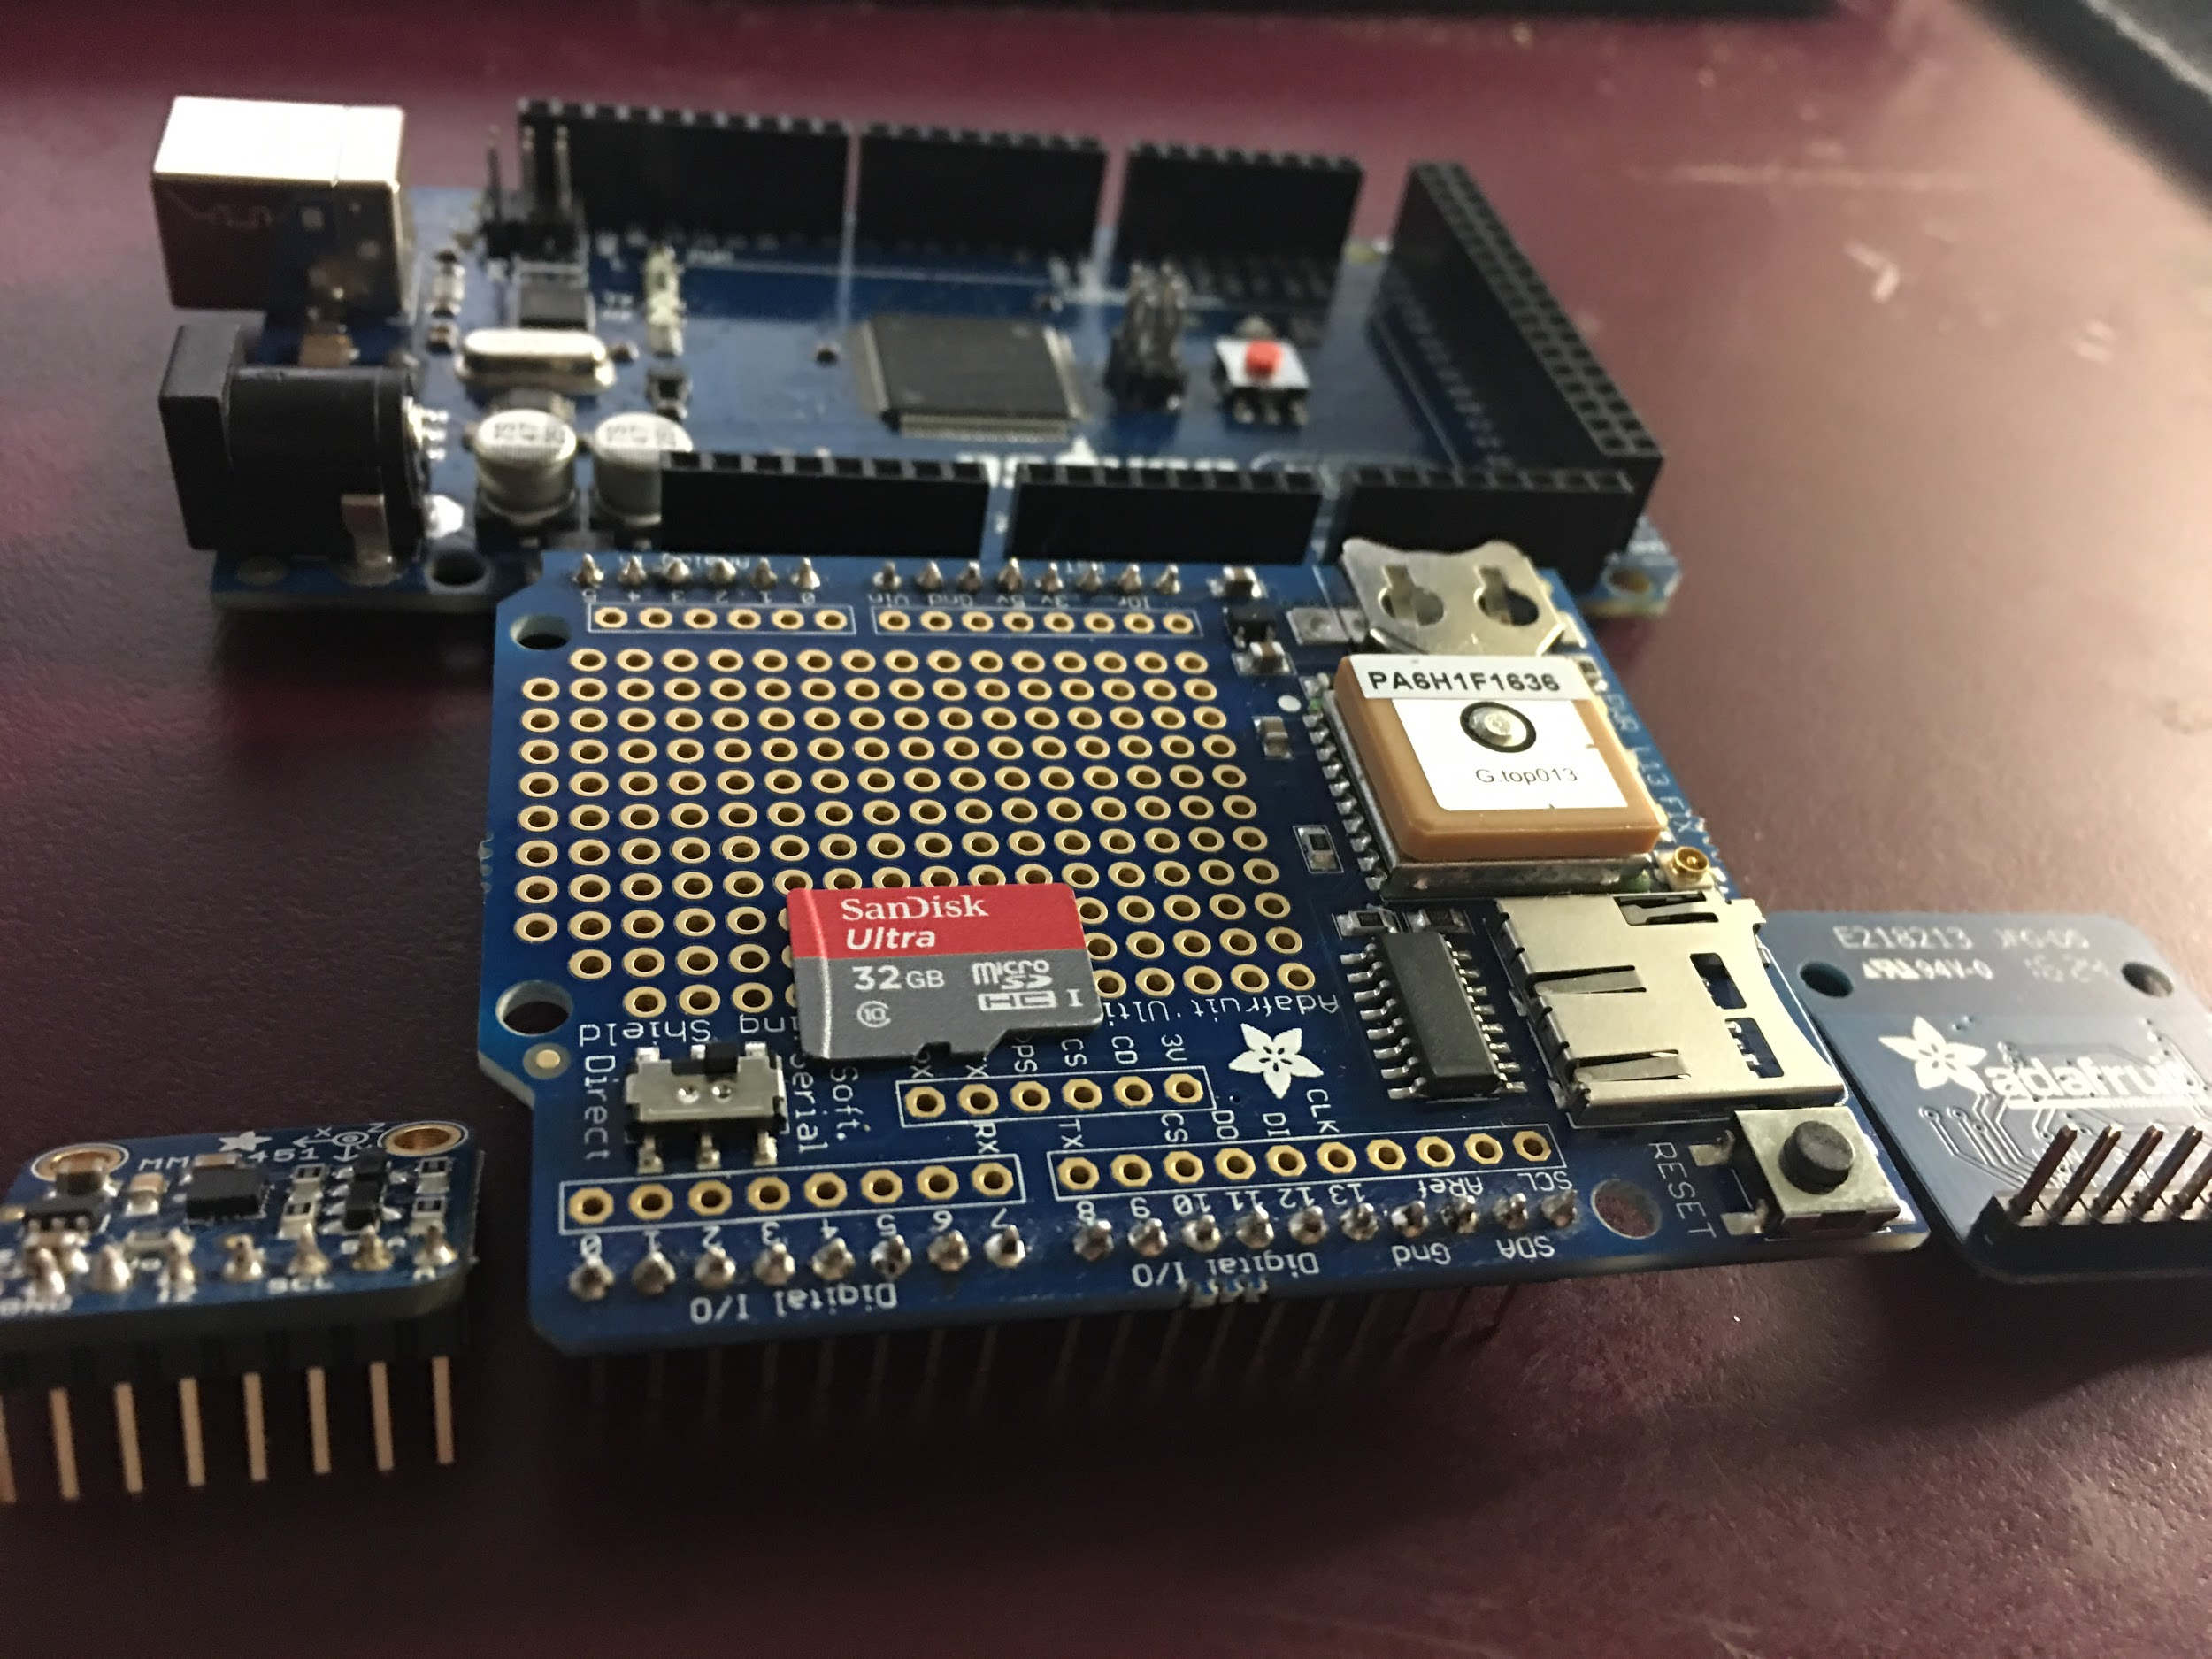
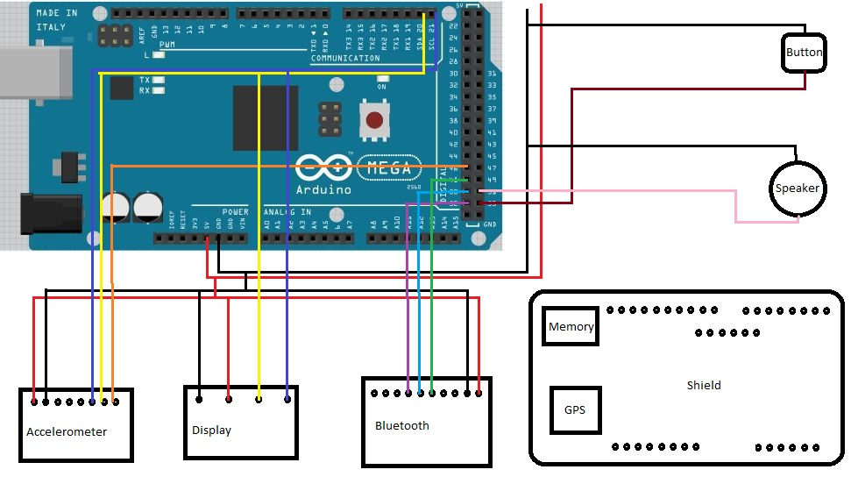
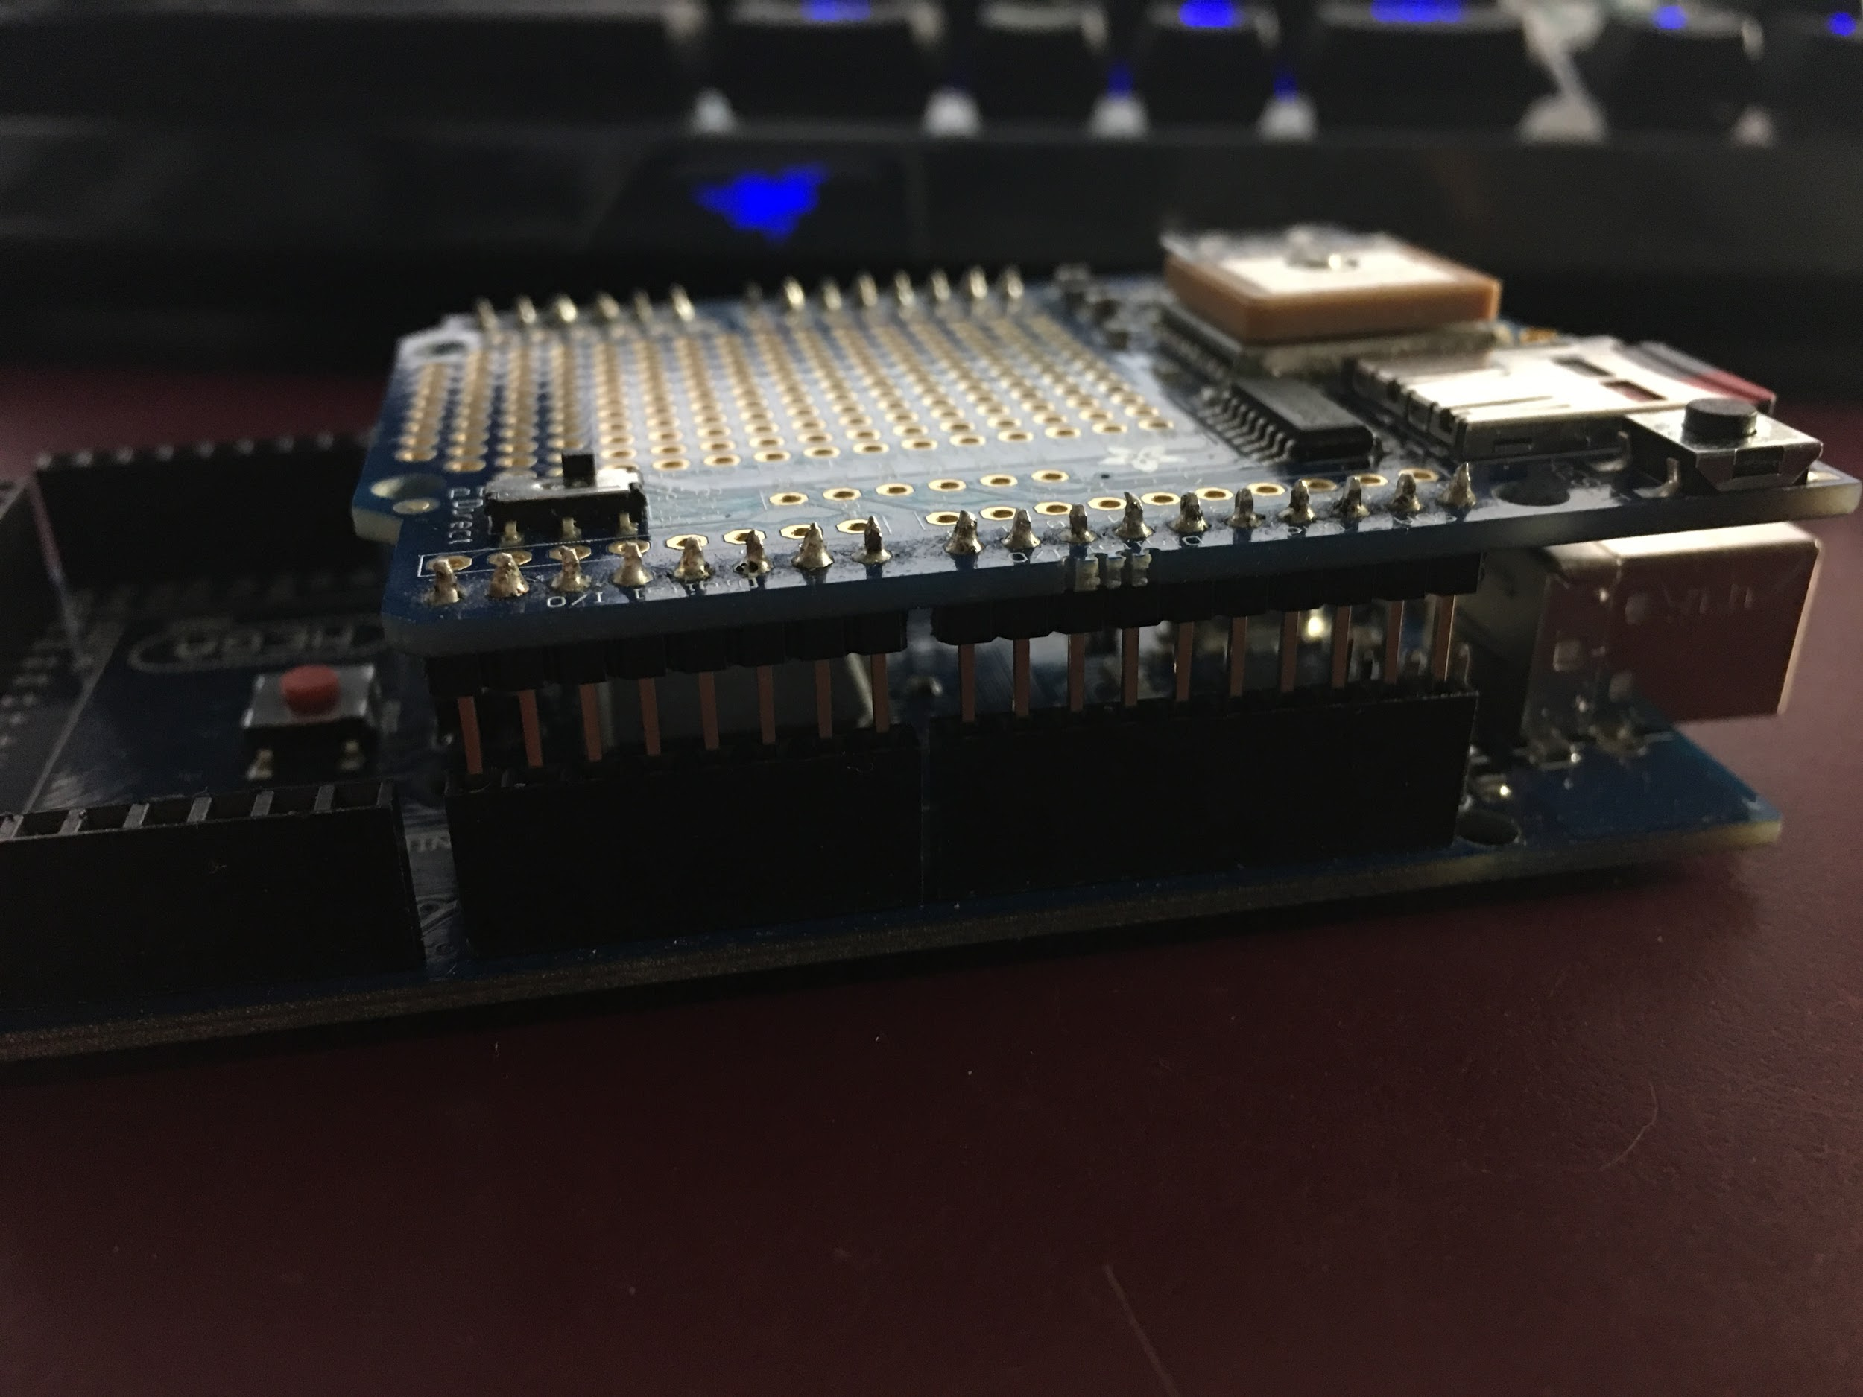
Wiring
GPS Logger Shield sits atop POWER, PWM and ANALOG IN (pins 0 - 5)
In Soft Serial mode: run wires from your TX1 and RX1 (18 & 19) to the RX and TX pinholes on the logger shield (8 & 7)
Address display to 0x1C (default) and accelerometer to 0x1D so you can run both on a single i2C (SCL & SDA)
Fits ^

Slide 8
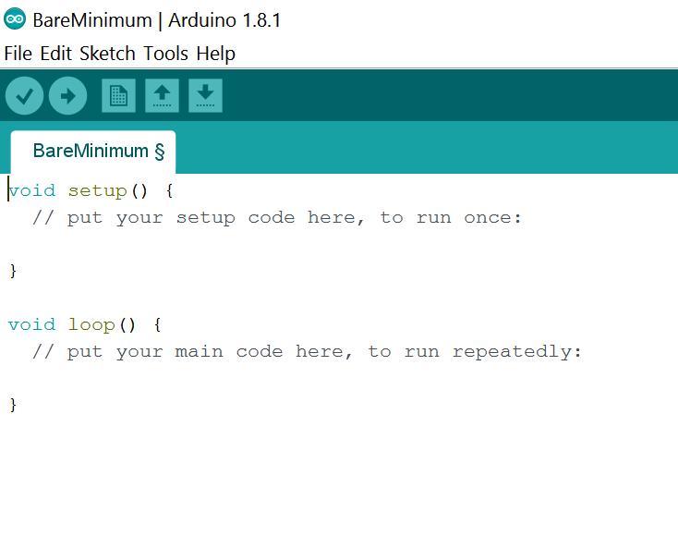
IDE
Checkmark: compile
Arrow: upload to board
Saved Sketch: .ino
Select your board and port in Tools

Slide 9
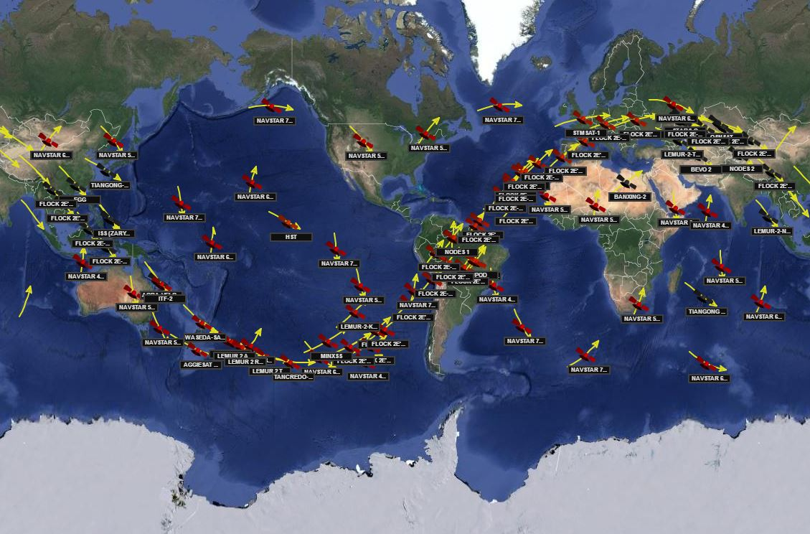
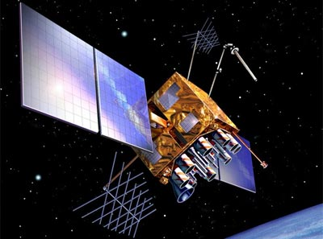
GPS
24 Satellites (American)
Orbit: 12 hours
At least 4 available
NAVSTAR

Slide 10
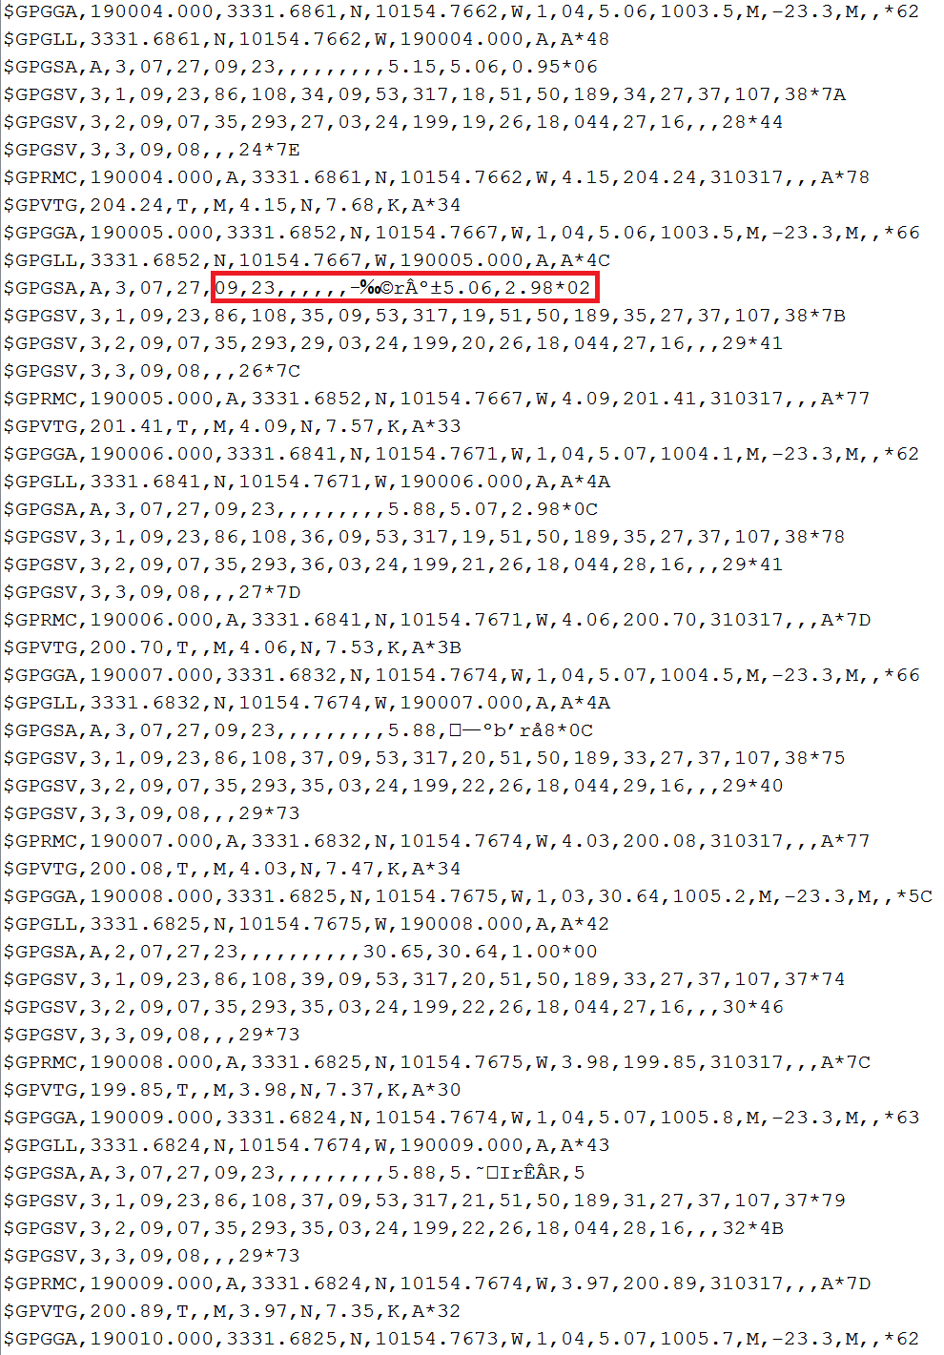
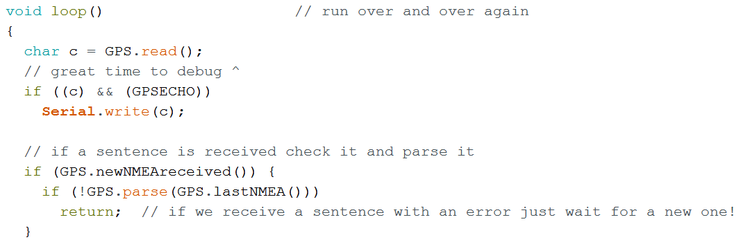
NMEA Sentences
They’re nearly unreadable. Parse them
Errors occur. Tolerate them
Don’t reinvent the wheel. Use libraries which suit your project. Adafruit_GPS.h is 10/10
GPS.parse(GPS.lastNMEA())

Slide 11
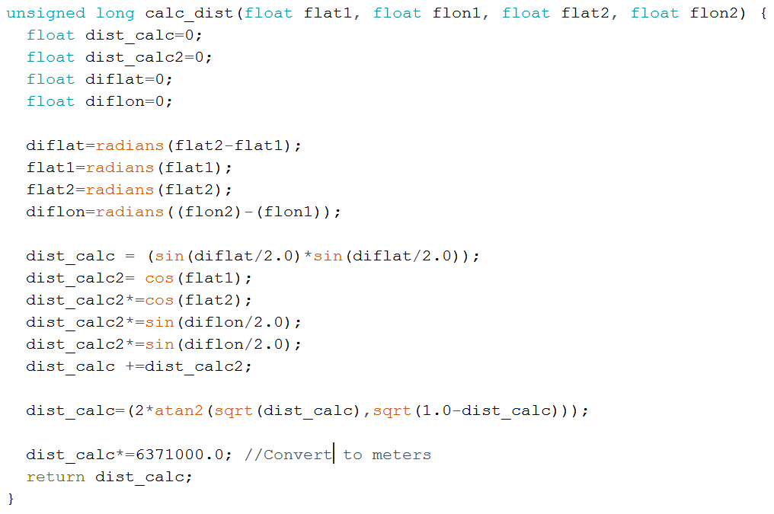
GPS Measurements
This function calculates the distance between two pairs of coordinates (degrees) in meters. This fn your bread and butter and is not included in Adafruit_GPS.h
With Adafruit_GPS.h included:
GPS.latitudeDegrees
GPS.longitudeDegrees
GPS.speed (knots)
GPS.altitude (meters)
GPS.satellites
GPS.year
GPS.month
GPS.day
GPS.hour (GMT)
GPS.minute
GPS.second

Slide 12
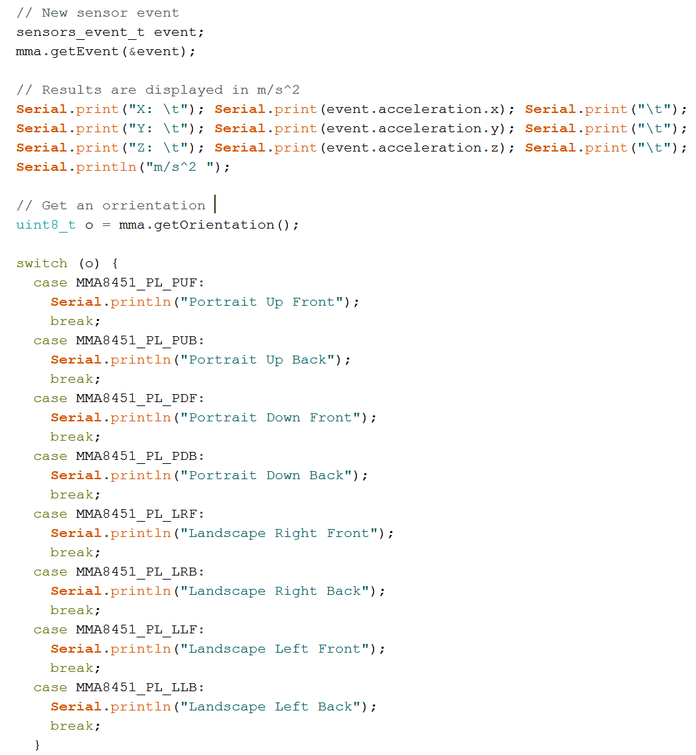
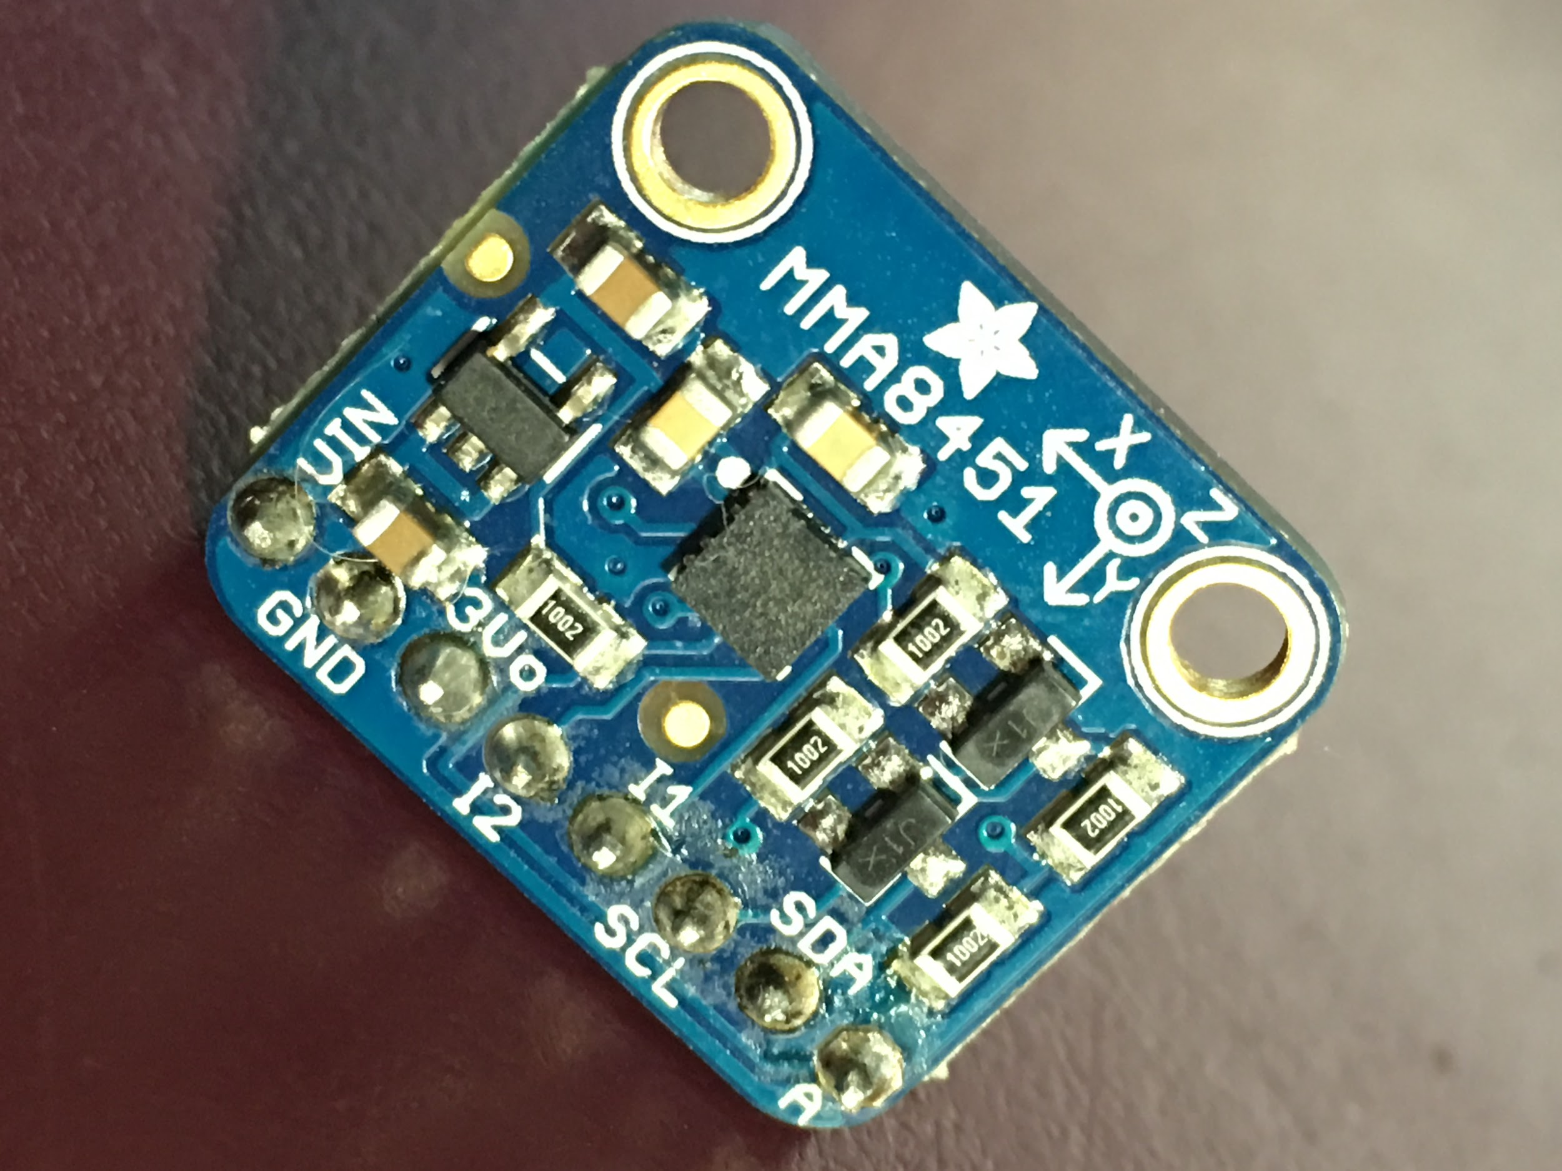
Accelerometer (i2C)
Measures acceleration (x y & z), tilt and orientation
Include Adafruit_MMA8451.h and Adafruit_Sensor.h
FANTASTIC conditional
IF (acceleration > some_range) // we’re moving THEN do_the_thing()

Slide 13
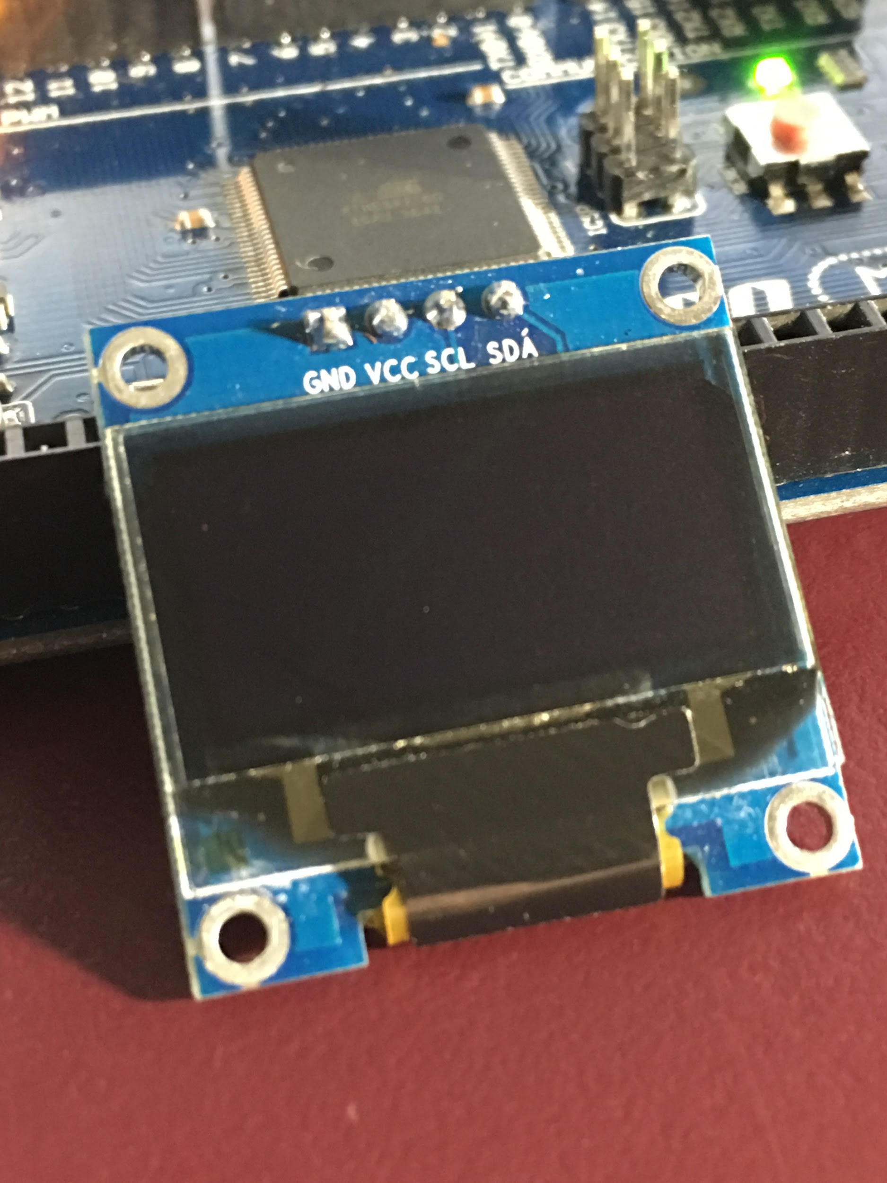
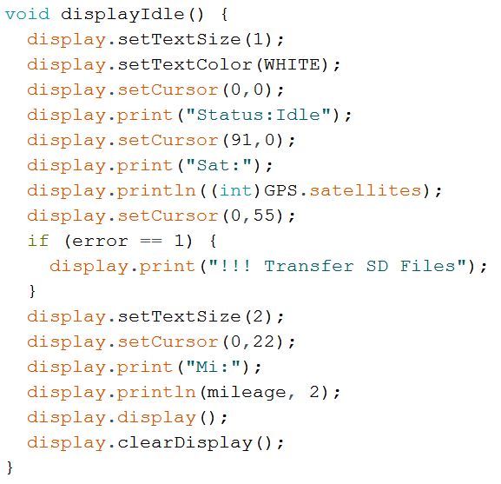
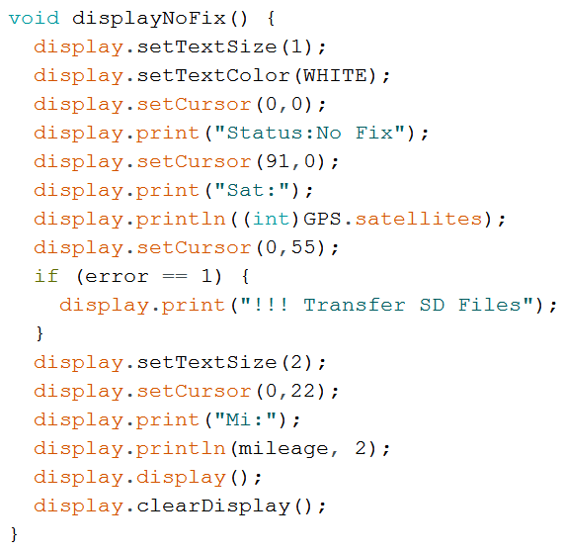
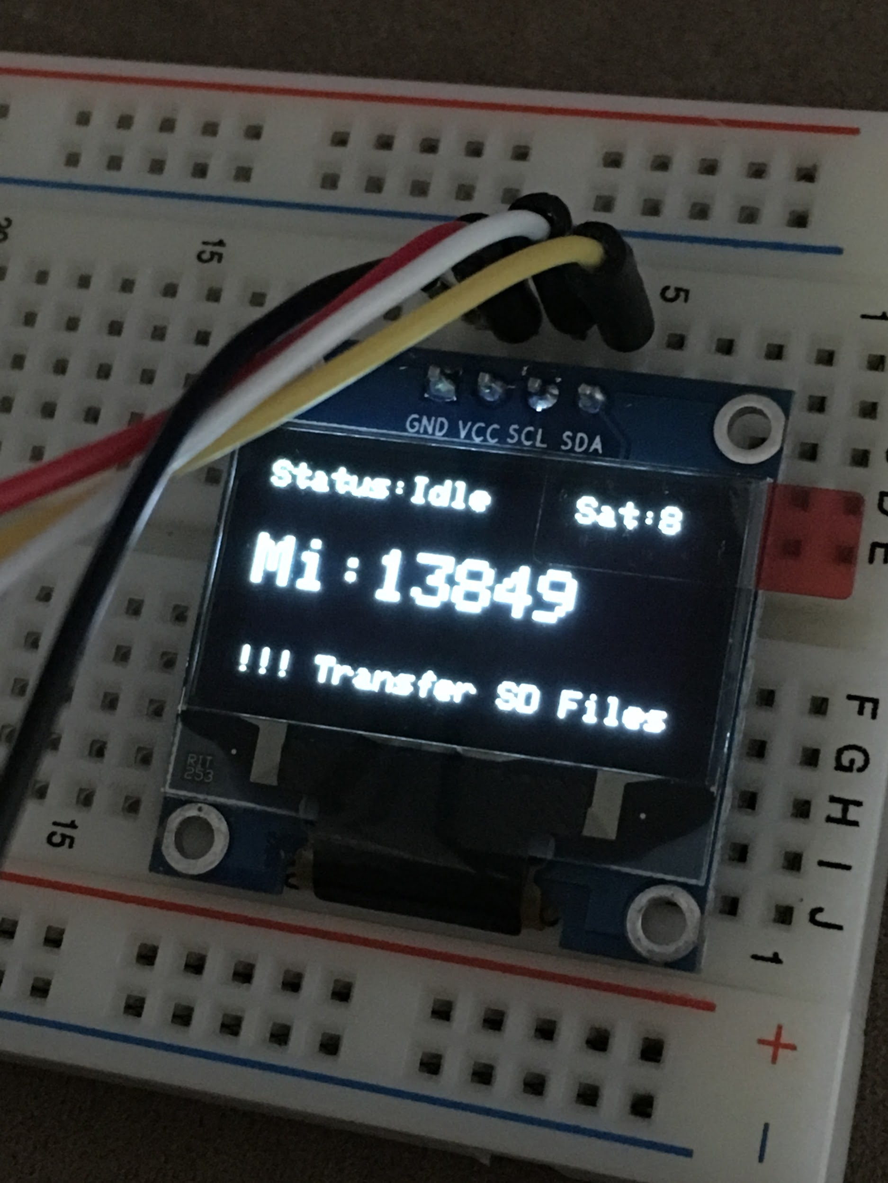
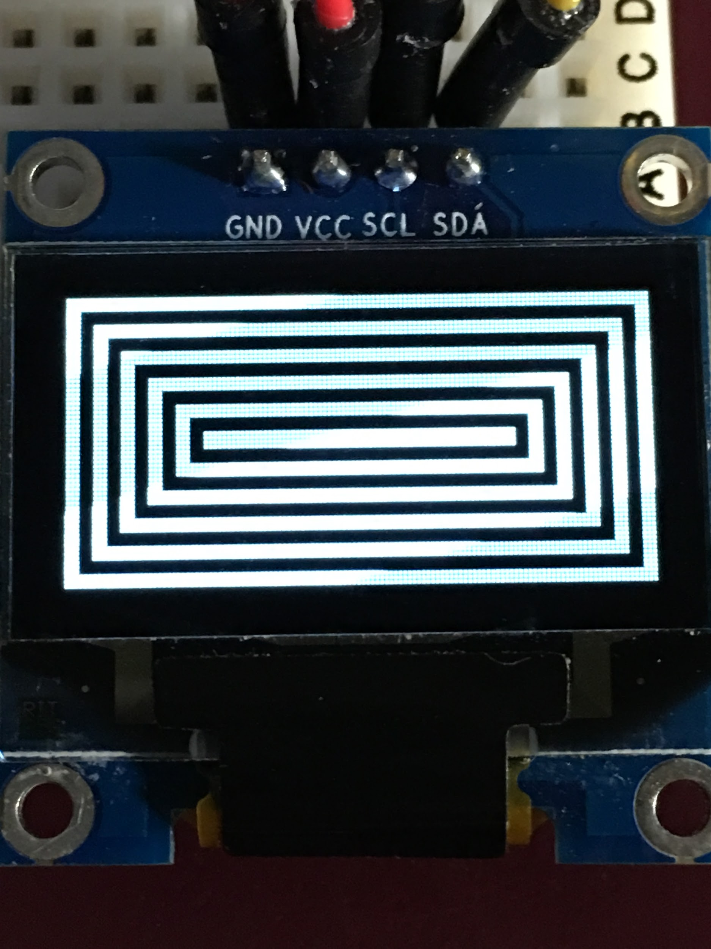
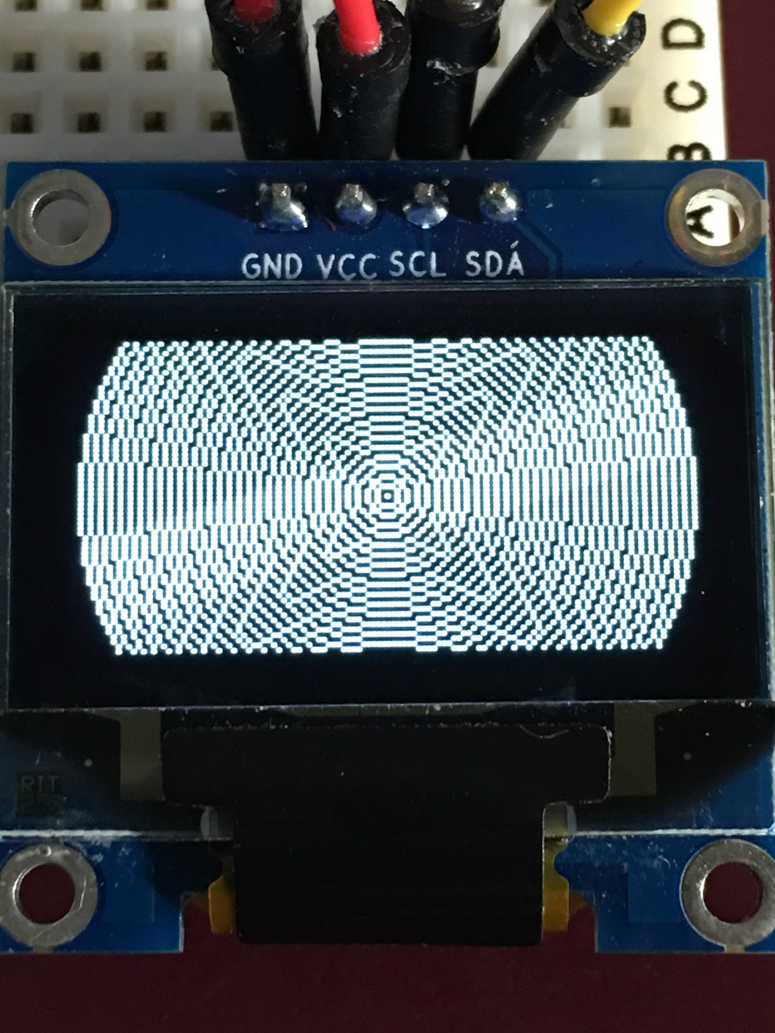
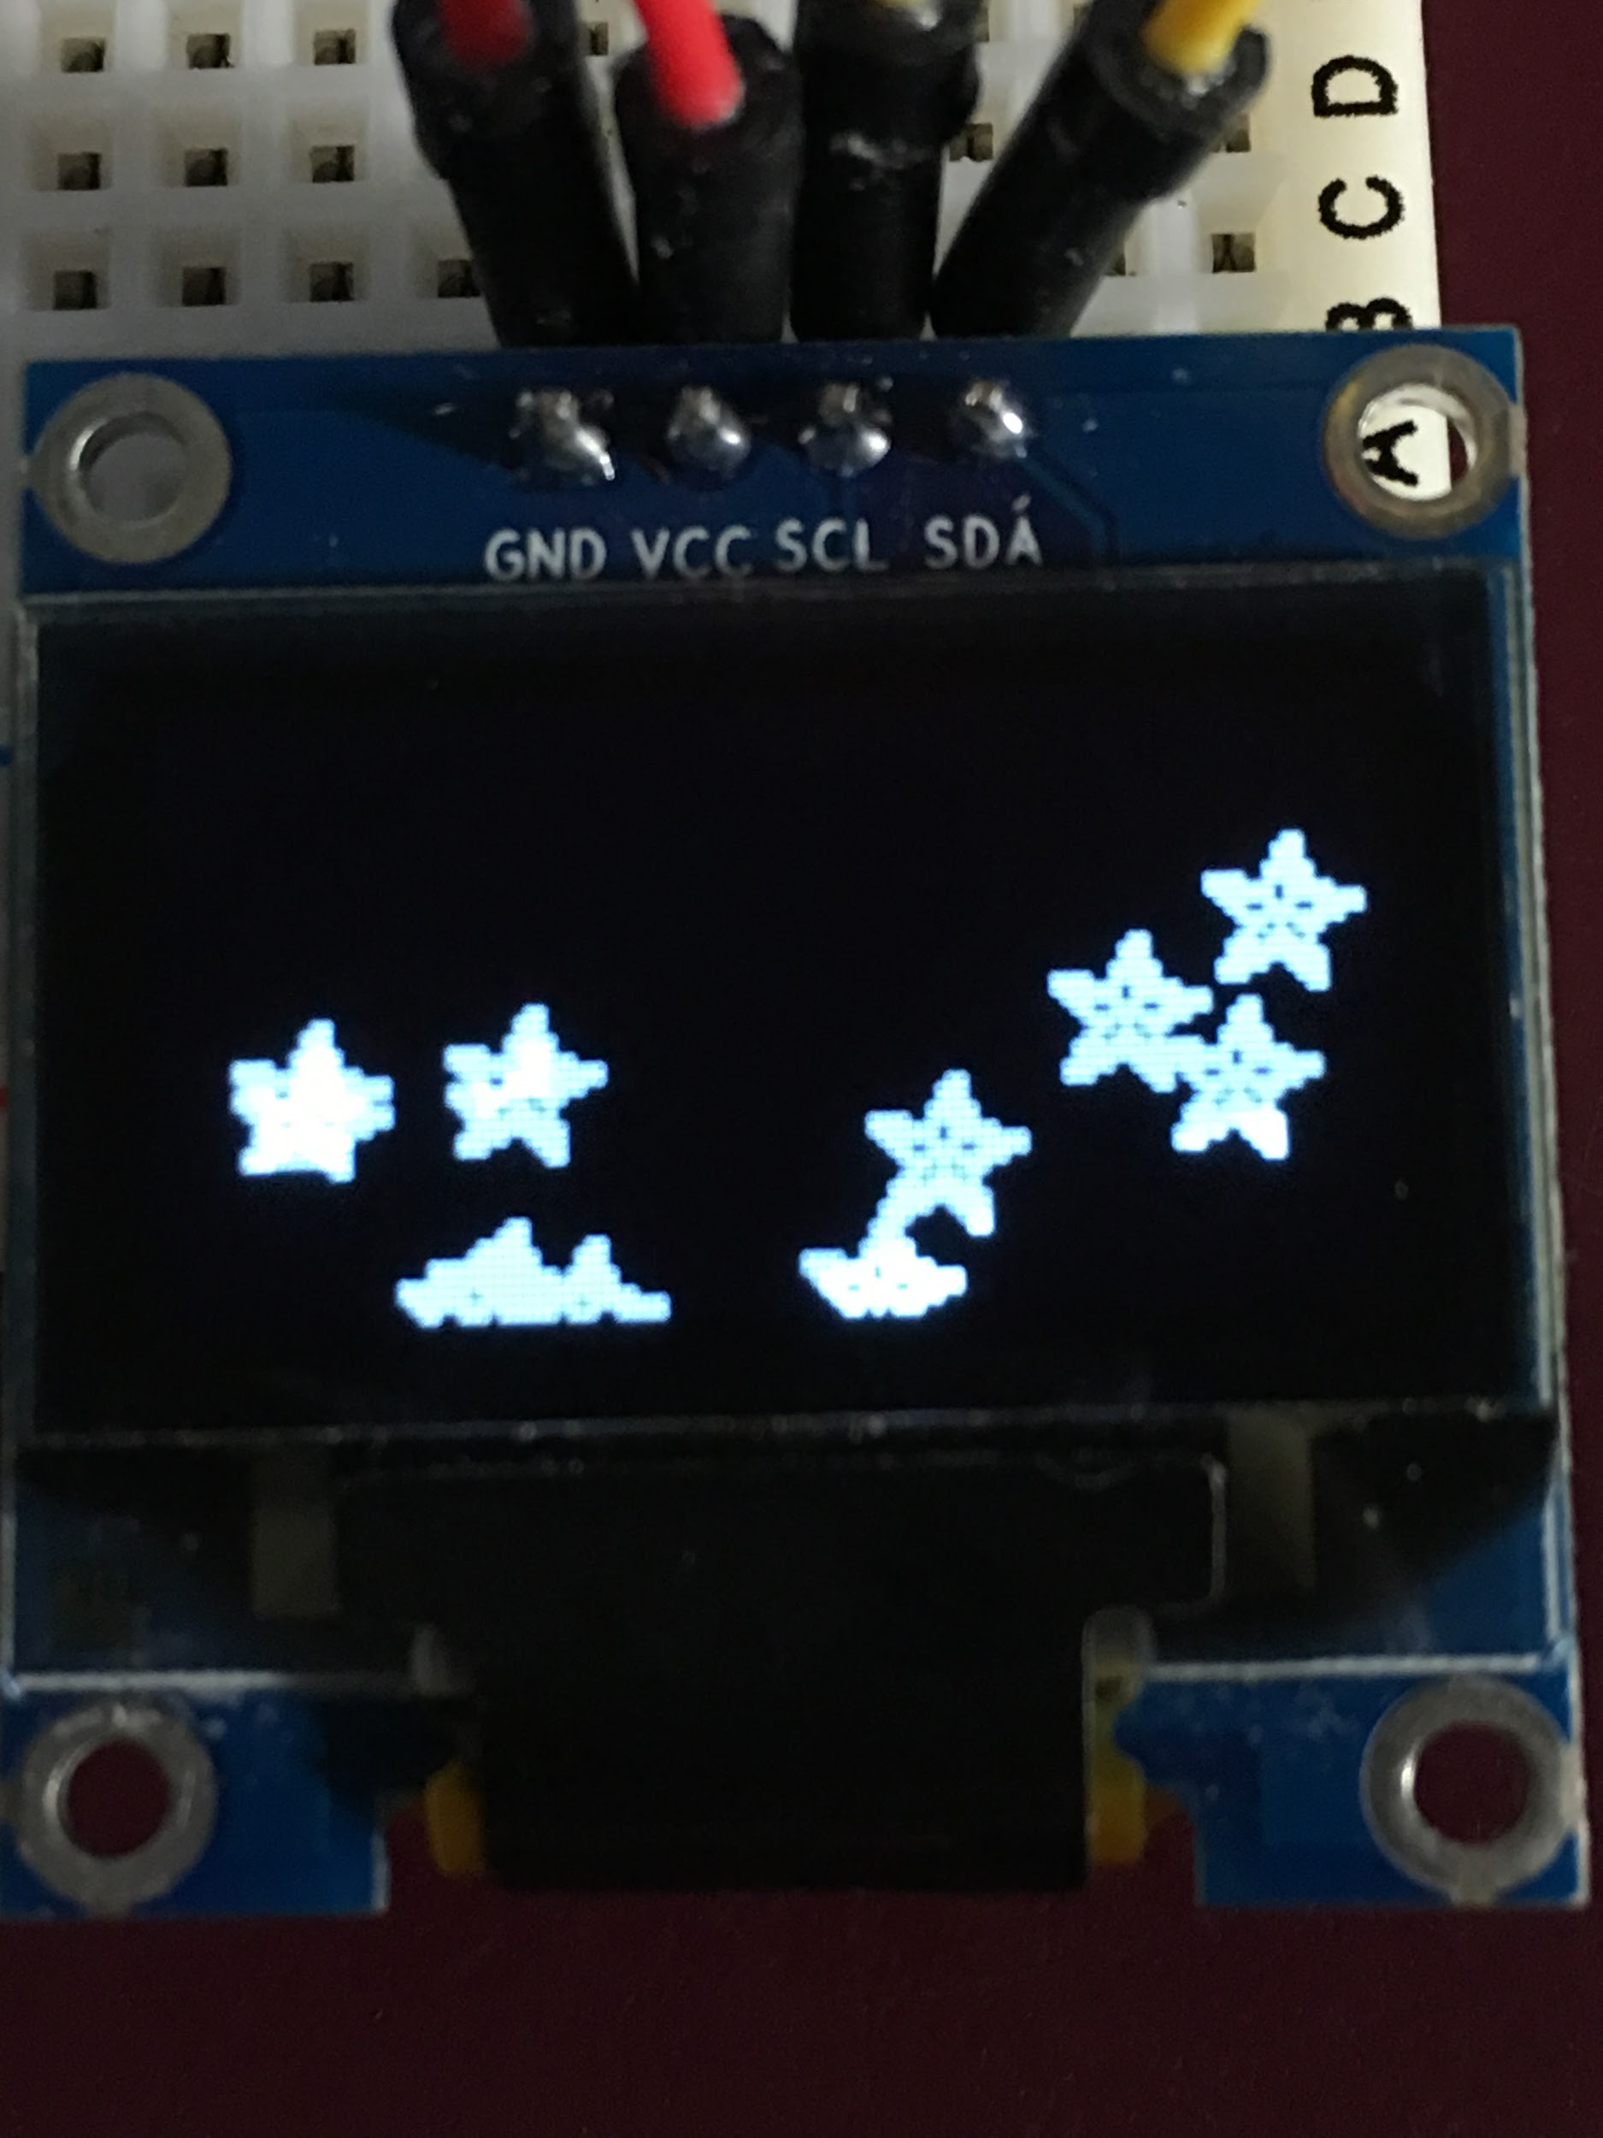
OLED Display (i2C)
Communicate without any data transfer
Include Adafruit_GFX.h and Adafruit_SSD1306.h
Excellent way to communicate errors

Slide 14
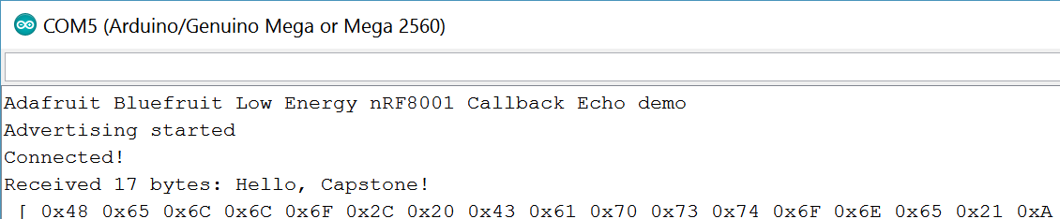
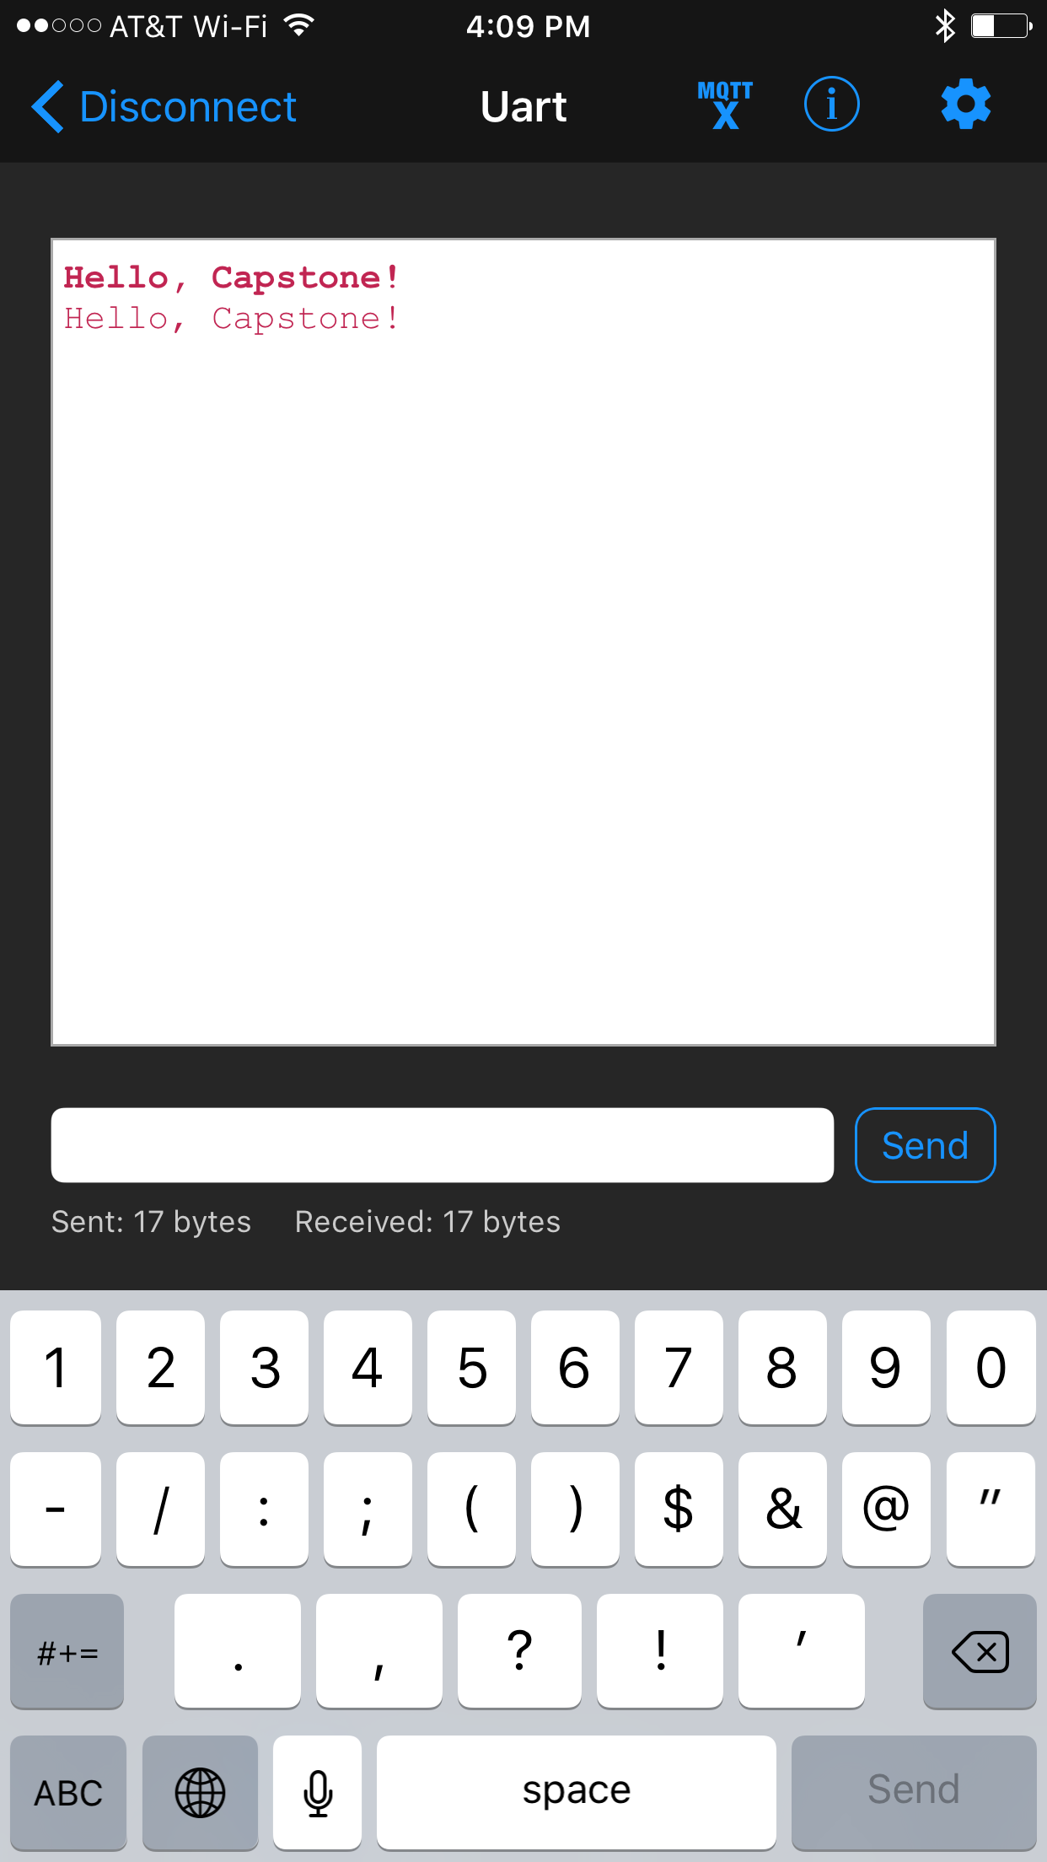
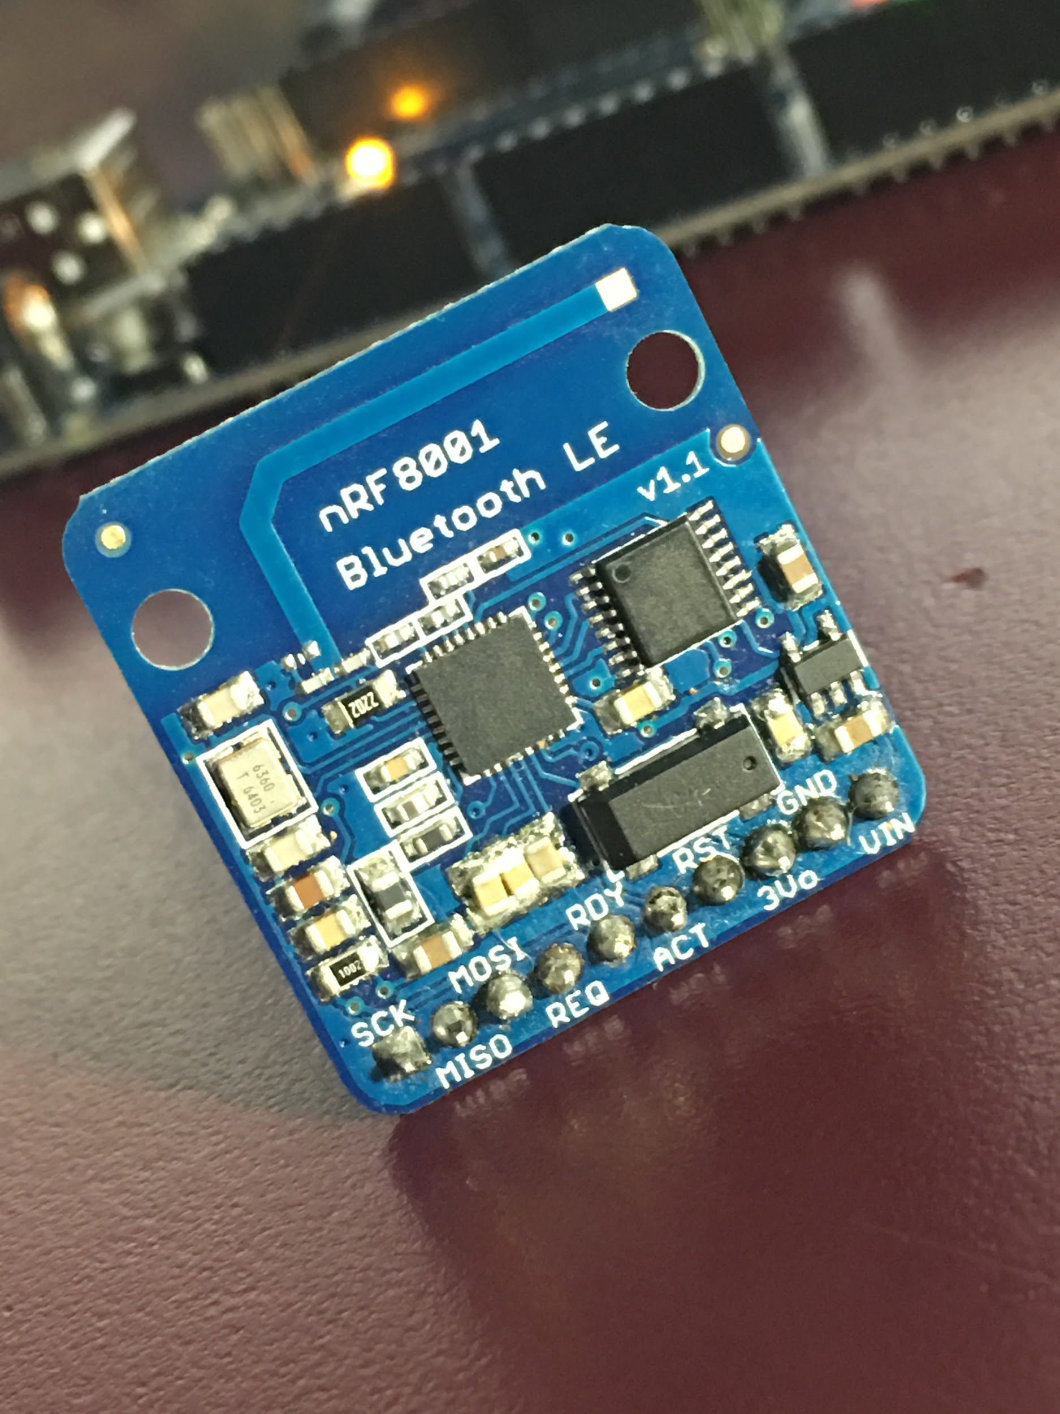
Bluetooth
Wireless communication
Include Adafruit_BLE_UART.h
BTLEserial.pollACI()
Data can only be transferred when you instruct the Bluetooth to poll for data. Considering an Arduino sketch is constructed around a single main loop, it’s important to call BTLEserial.pollACI() anywhere it makes sense.

Slide 15
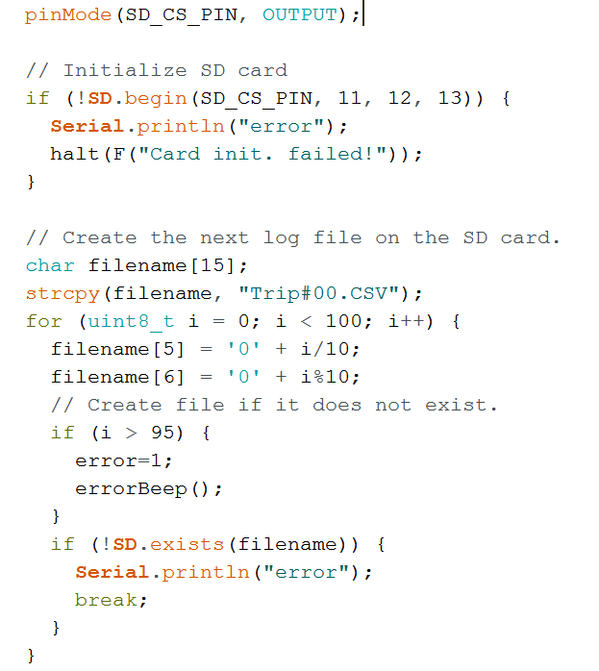
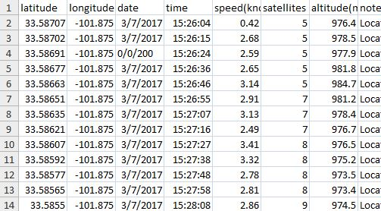
Data Logging
Save your measurements in a file type that suits your project. (Google Maps ‘s .CSV)
Include SD.h for an easy life

Slide 16
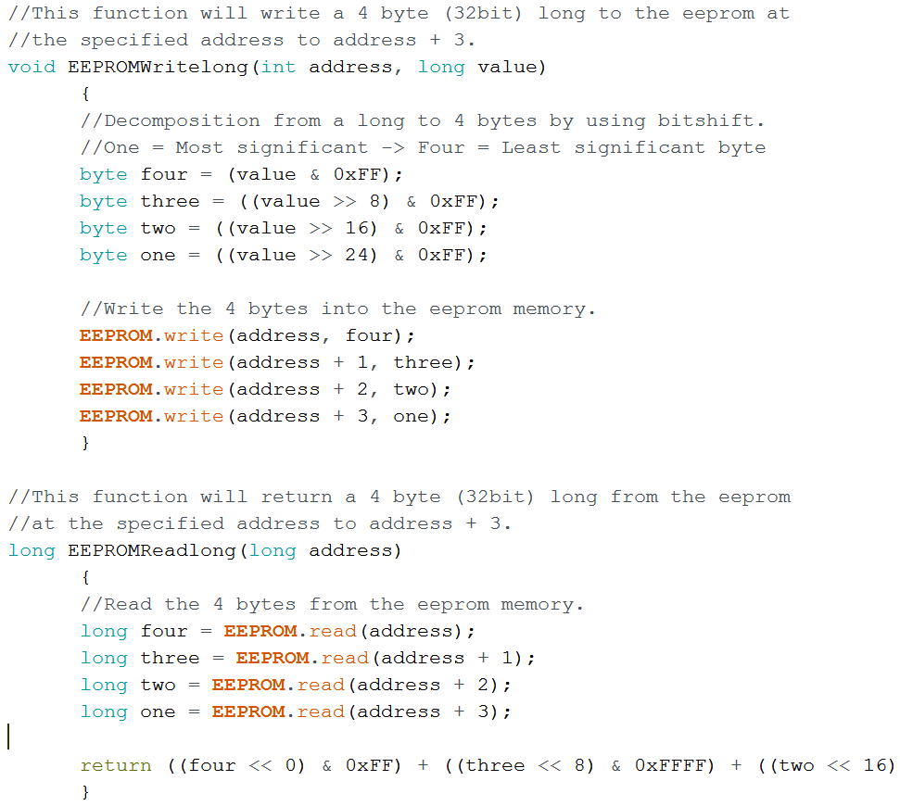
EEPROM
Special memory type
Doesn't corrupt data when power is lost
Include EEPROM.h
Limited read/writes
Possible Implementation: Add and save your total trip mileage to EEPROM if it was a business trip. At the end of the year, you can read your running total of business miles and write them off on your taxes. If power is lost, so is the totalMileage variable that’s in the program memory. This is why EEPROM is bae.

Slide 17
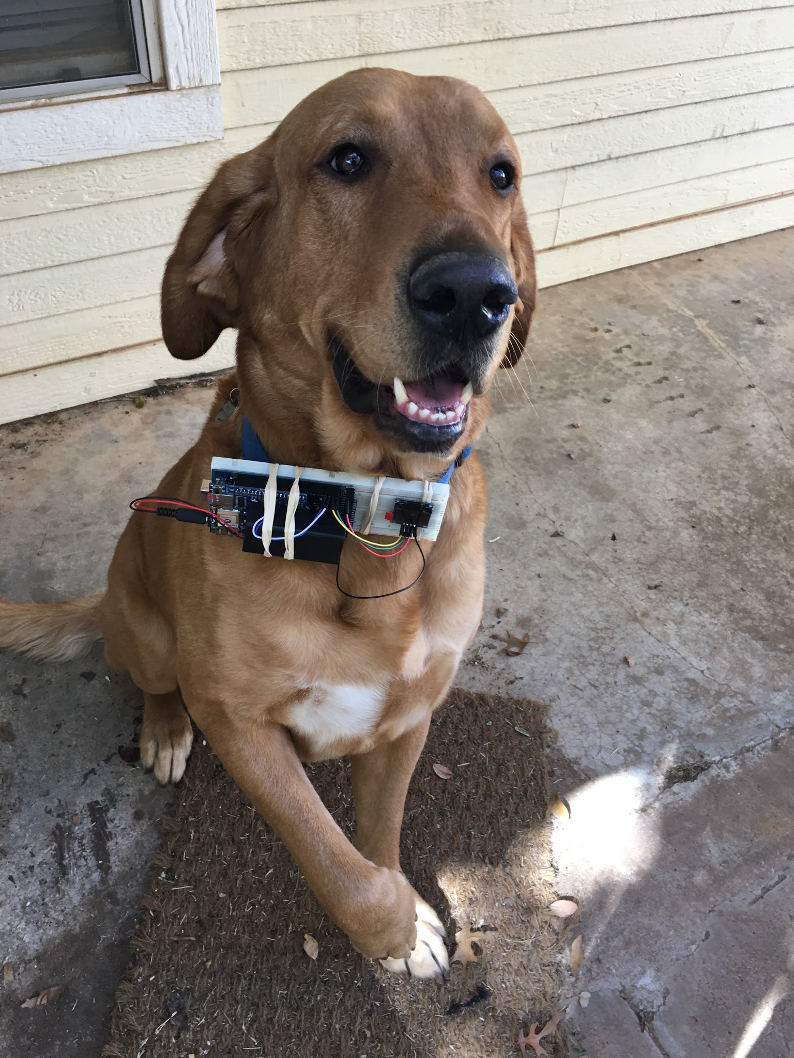
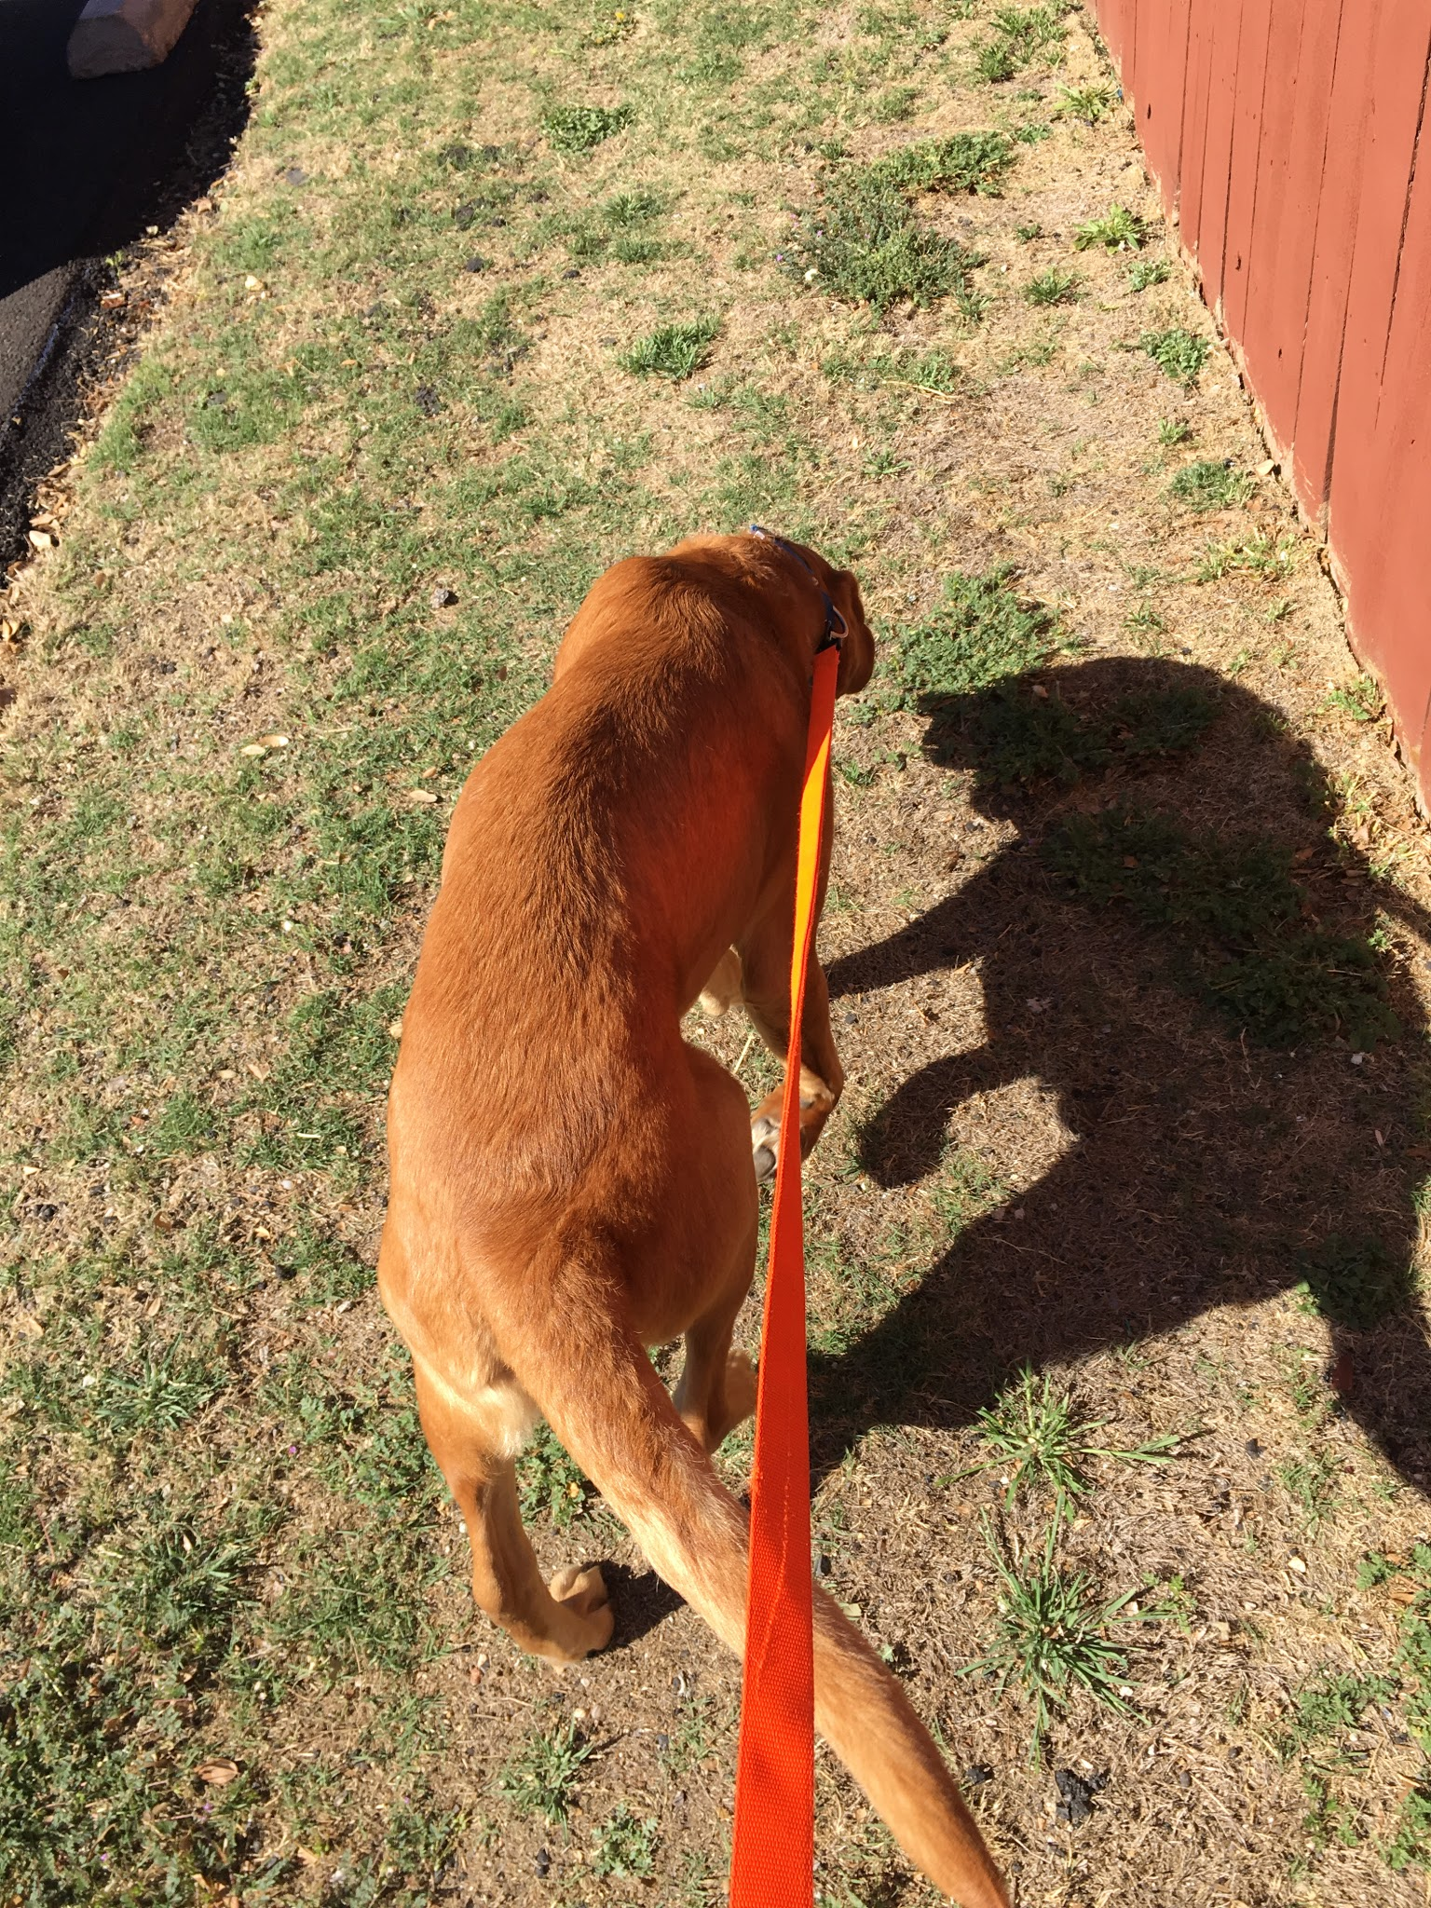
Possible Implementation: Walking a doggo
Attach Waldo to pupper
Walk said pupper
Visualize handy pupper-walking data

Slide 18
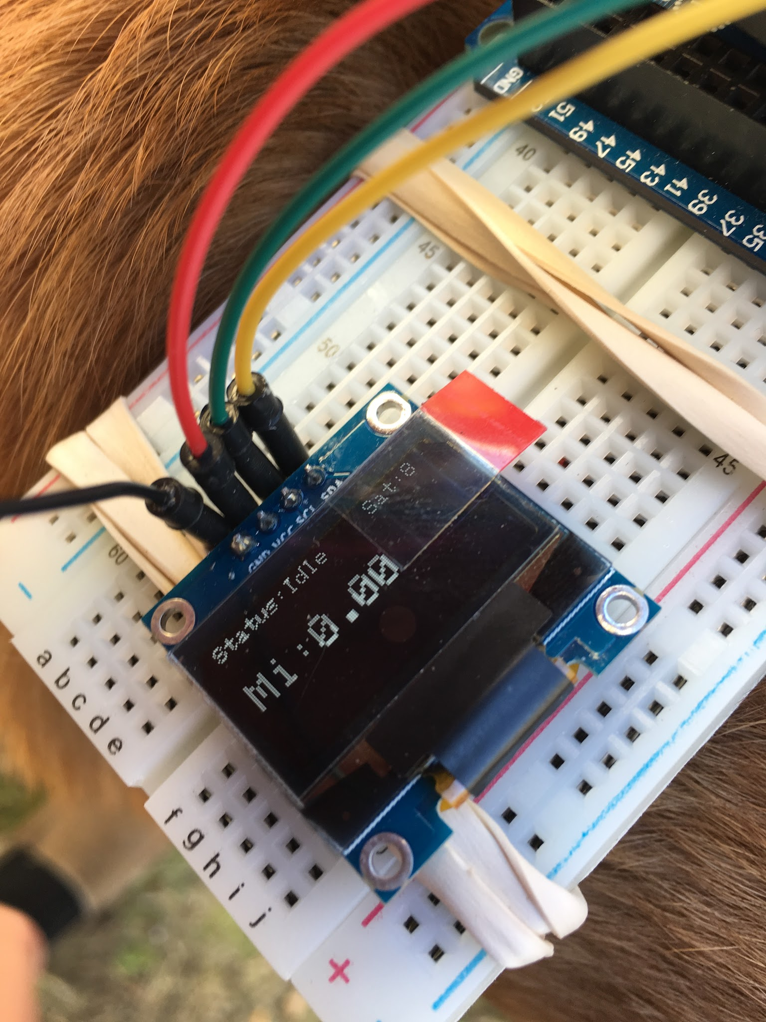
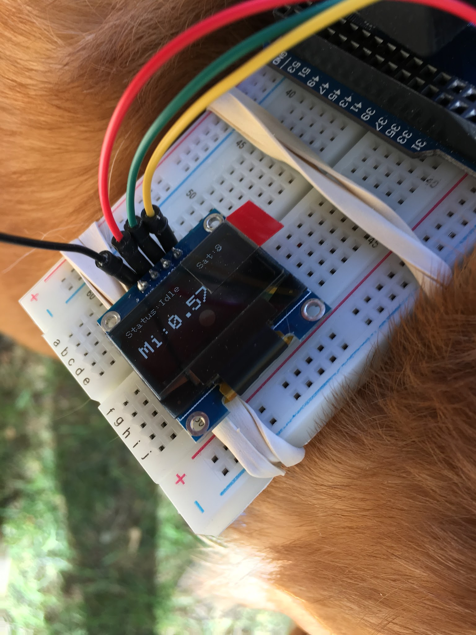
Charlie goes for a walk

Slide 19
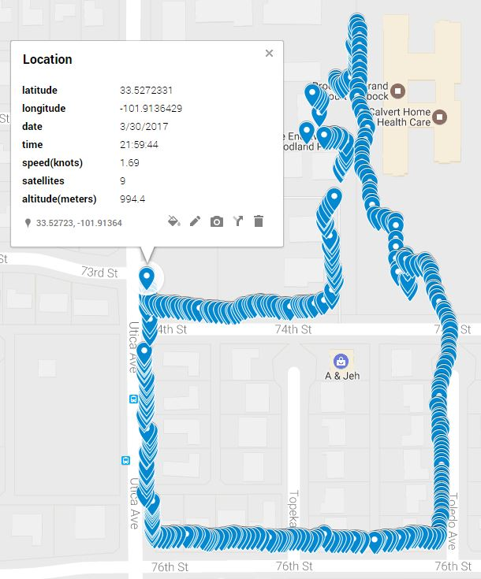
Charlie goes for a walk
.57 mile walk
Mapping should you need to remember/visualize your path
Charlie for POTUS! Hindsight 2020

Slide 20
Questions ?

